Slide 1
Marketing
Product, Services and Branding Strategies

Slide 2
Product and Service Classification
Consumer product: A product bought by final consumers for personal consumption.
Convenience product: A consumer product that customers usually buy frequently, immediately, and with minimal comparison and buying effort.
Shopping product: A consumer product that the customer, in the process of selecting and purchasing, usually compares on such attributes as suitability, quality, price, and style.
Specialty product: A consumer product with unique characteristics or brand identification for which a significant group of buyers is willing to make a special purchase effort.
Unsought product: A consumer product that the consumer either does not know about or knows about but does not normally consider buying.
Industrial product: A product bought by individuals and organizations for further processing or for use in conducting a business.

Slide 3
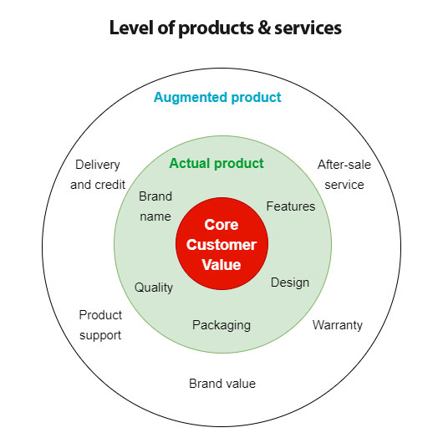
An augmented product is an additional benefit or special service supporting the main product. Sellers use this method to provide their clients with additional value for free. Offering a warranty is an example of product augmentation.

Slide 4
Packaging and Labeling
Packaging: The activities of designing and producing the container or wrapper for a product.
Labeling and Logos: Labels and brand logos can support the brand’s positioning and add personality to the brand. Labels and logos range from simple tags attached to products to complex graphics that are part of the packaging. They perform several functions, the label identifies the product or brand, and clarifies: who made it, where it was made, when it was made, its contents, how it is to be used, and how to use it safely. Finally, the label might help to promote the brand and engage customers.

Slide 5
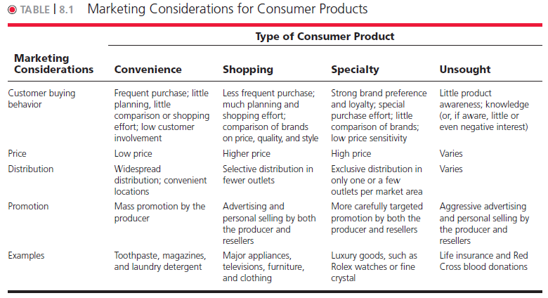

Slide 6
What is branding?
Branding is “a name, term, sign, symbol, or design, or a combination of them,” These visual elements are “intended to identify the goods or services of one seller or group of sellers and to differentiate them from those of competitors.”
Branding is a company’s unique identity that distinguishes it from its competitors. It’s why customers choose one brand over another.
Brand equity: The differential effect that knowing the brand name has on customer response to the product or it, Brands vary in the amount of power and value they hold in the marketplaces marketing. positive brand equity derives from consumer feelings about and connections with a brand. A brand with high brand equity is a very valuable asset. Brand value is the total financial value of a brand.

Slide 7
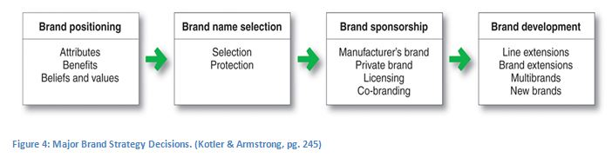
Brand Positioning
When positioning a brand, the marketer should establish a mission for the brand and a vision of what the brand must be and do. A brand is the company’s promise to deliver a specific set of features, benefits, services, and experiences consistently to buyers. The brand promise must be clear, simple, and honest.

Slide 8
Brand Name Selection
Desirable qualities for a brand name include the following:
(1) It should suggest something about the product’s benefits and qualities: Instagram, Slimfast, Snapchat, Pinterest.
(2) It should be easy to pronounce, recognize, and remember: iPad, Tide, Jelly Belly, Twitter, JetBlue.
(3) The brand name should be distinctive: Panera, Swiffer, Zappos, Nest.
(4) It should be extendable—Amazon.com began as an online bookseller but chose a name that would allow expansion into other categories.
(5) The name should translate easily into foreign languages. The official name of Microsoft’s Bing search engine in China is bi ying, which literally means “very certain to respond” in Chinese.
(6) It should be capable of registration and legal protection. A brand name cannot be registered if it infringes on existing brand names.

Slide 9
Brand Development
Line extension, extending an existing brand name to new forms, colors, sizes, ingredients, or flavors of an existing product category. KFC has extended its “finger lickin’ good” chicken lineup well beyond original recipe, bone-in Kentucky fried chicken. It now offers boneless fried chicken, wings, chicken tenders etc.
Brand extension, extending an existing brand name to new product categories. Dove, initially known for its beauty bars, expanded into body washes, shampoos, deodorants, and men's grooming products.
A multi-brand strategy means having a portfolio of products with different brands or names, all owned and managed by the same company. Nestlé has a multi-brand portfolio of so many brands, including Nescafe,FruitaVitals,Nido and KitKat.
The new brand strategy means developing a new product line and a brand that would be associated with it. The product line needs to be outside the scope of the current brand offering, that's why it requires a new brand. For example, Toyota created the separate Lexus brand aimed at luxury car consumers and the Scion brand targeted toward millennial consumers.

Slide 10
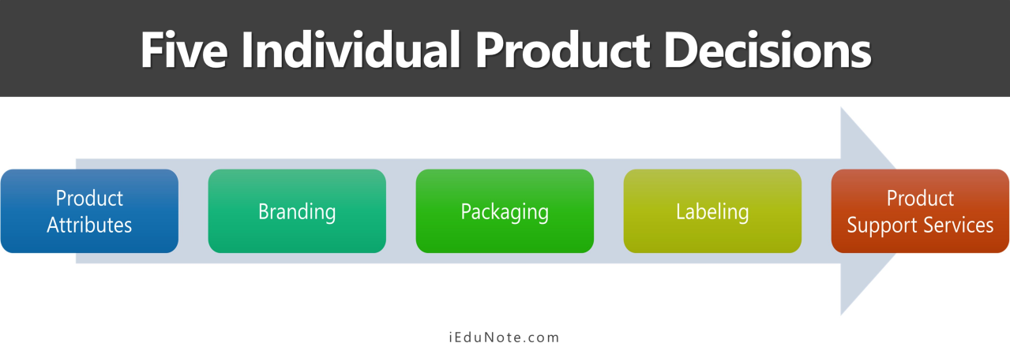

Slide 11
Think then answer:
Store brands can claim considerable market share. Select any 2 typical grocery brand products of Pakistan and compare prices, quality, and manufacturing source. How similar are they to one another and to national brands? How does their stock level and store position compare to national brands in direct competition with them?

